Slide 1

Git & GitHub
Nikhil Prabhu (Trainer)
Aravind Venkata (Co-Trainer)
August 14, 2024

Slide 2
Agenda
Version Control – Definition and importance.
Types of Version Control Systems and Architectures.
Git & GitHub – An Overview.
Git Operations.
GitHub features.
Interactive Session.
Notes:
2

Slide 3
Version Control

Slide 4
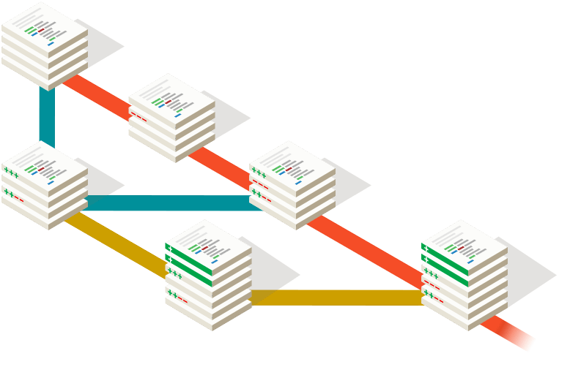
What is “Version Control”?
Version Control is the practice of tracking and managing changes to software code.
It is also known as “source control”.
Can be used to manage changes in source code, as well as other technical or non-technical content (text documents, binary files, etc.).
Version Control systems track and store changes in an efficient manner.

Slide 5
Why is Version Control important?
Manually managing different versions of a product can be tedious and will almost certainly be error-prone.
Without Version Control systems, collaboration becomes harder.
Version Control makes it very easy to traverse the history of a project, and even helps in identifying changes that may have introduced a bug/flaw (and even see who made the changes).

Slide 6
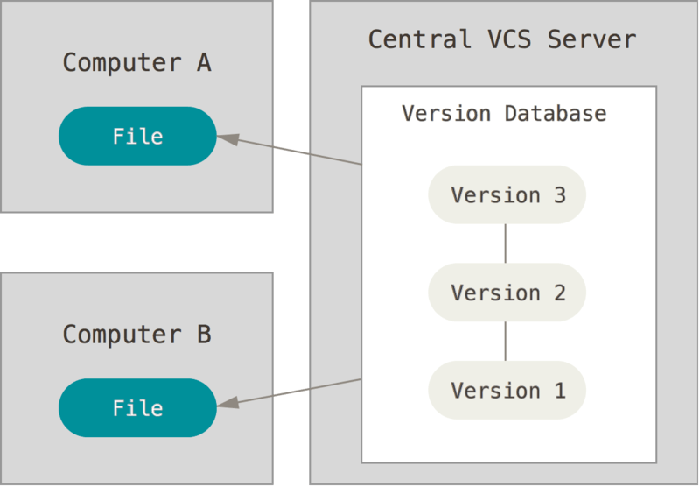
Version Control Architectures - Centralized
In this architecture, there exists a central VCS server that houses the project repository.
Each individual developer will have to connect to this VCS server and work simultaneously on the repository.
If the central server fails, everyone’s work is affected. It can even cause a loss of data.

Slide 7
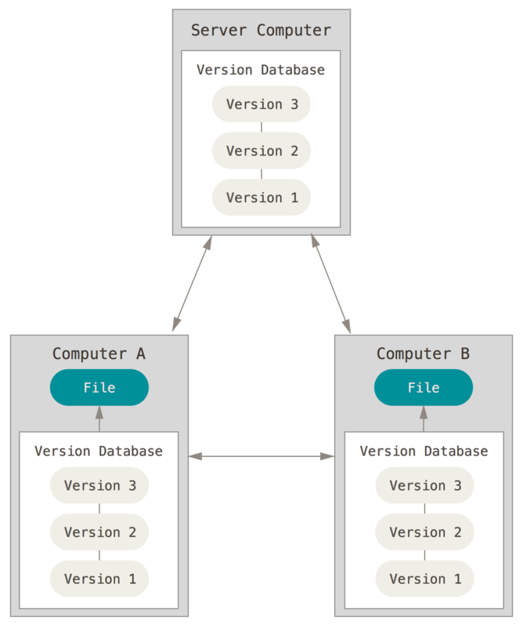
Version Control Architectures - Distributed
In this architecture, each developer’s device contains a local copy of the main repository.
Changes can be made to each copy independently, and can later be pushed to a central repository.

Slide 8
Version Control Systems
Centralized – CVS, Subversion (SVN) and Perforce.
Distributed – Mercurial, Git and Bazaar.

Slide 9
Git & GitHub

Slide 10

Git – An Overview
Git is a distributed version control system.
Created by Linus Torvalds in 2005, for the development of the Linux kernel. Currently maintained by Junio Hamano.
Was developed as a replacement for the proprietary VCS BitKeeper.
Was initially developed only for maintaining the Linux kernel, but is currently one of the mostly widely used development tools in the world, for various projects.

Slide 11

GitHub – An Overview
GitHub is a cloud hosting solution for Git-managed software repositories.
Offers the features of Git, along with other source control management (SCM) features (pull requests, GitHub Actions, etc.).
One of the most famous Git-hosting solutions; others being GitLab, Atlassian BitBucket, etc.

Slide 12
Git Operations

Slide 13
Git Operations & Commands – An Overview
git init
Creating Repositories
clone
branch
push
Git
Parallel Development
Syncing Repositories
merge
pull
rebase
add origin
Making Changes
status
add
commit

Slide 14
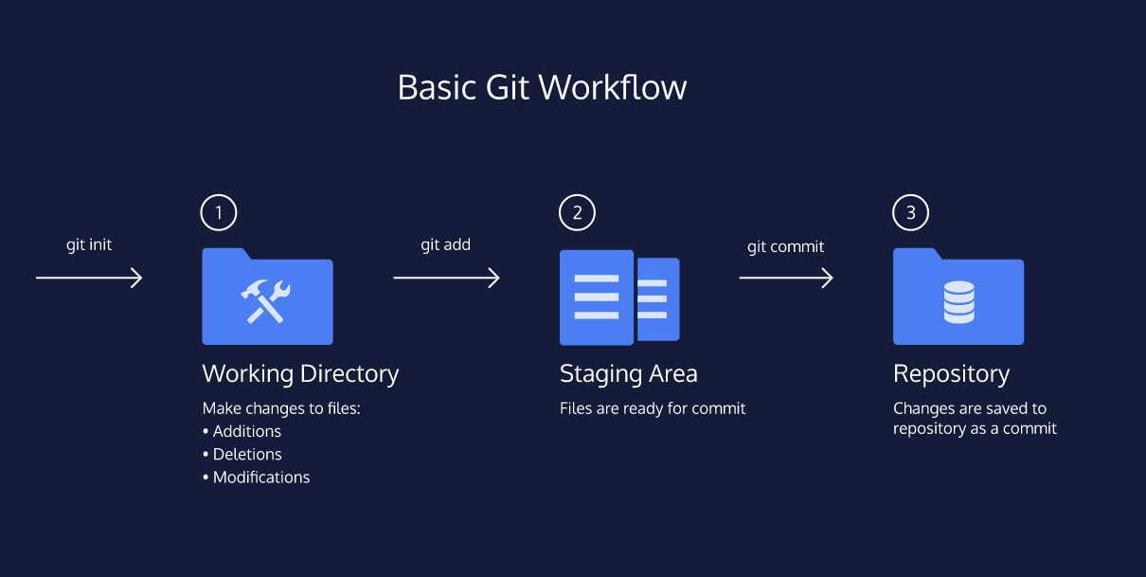
Git Operations – Workflow

Slide 15
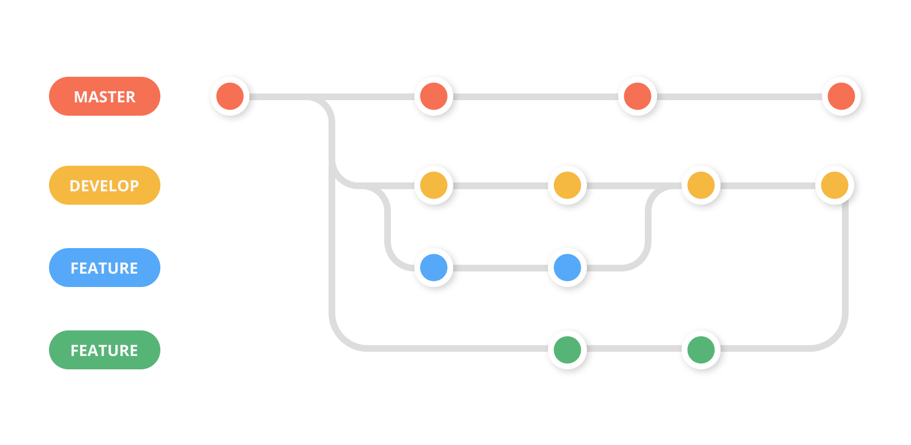
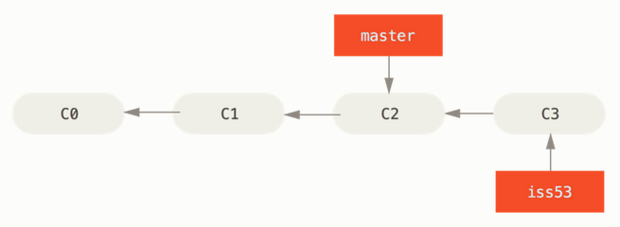
Git Operations – Branching
A branch is a pointer to a specific commit.
They can be independent local branches, or remote-tracking branches.

Slide 16
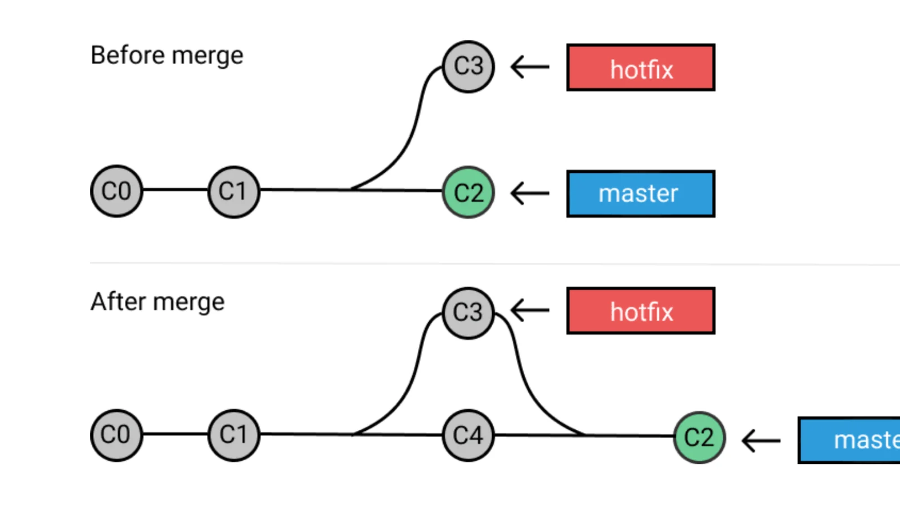
Git Operations – Merging
Merging combines sequences of commits into one unified history of commits.
Git can automatically merge commits unless there are changes that conflict in both commit sequences.

Slide 17
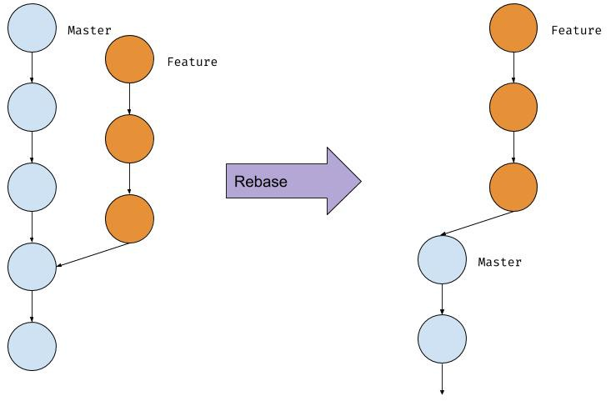
Git Operations – Rebasing
Rebasing is the process of moving or combining a sequence of commits to a new base commit.
Helps in maintaining a linear project history.

Slide 18
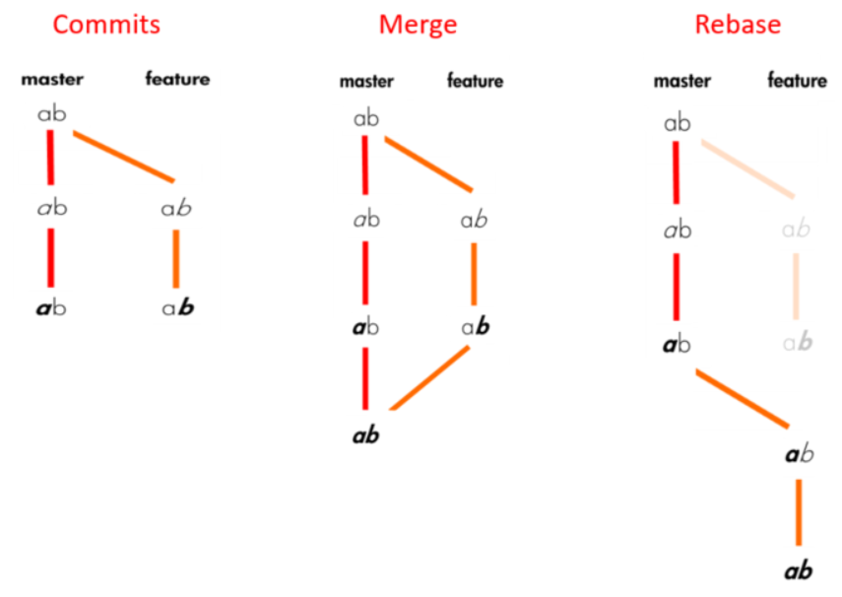
Git Operations – Merging vs Rebasing

Slide 19
Git Operations – Rebasing vs Merging
Rebasing is better to streamline the project history – using an interactive rebase, you can change or modify the commit history. You can remove unwanted commits, edit the commit message or combine two or more commits into one.
Merging is better when you want to preserve the project history.
Rebasing will present conflicts one commit at a time; Merging will present all the conflicts collectively after the merge operation is done.
Merging preserves history, while rebasing rewrites history.

Slide 20
GitHub Features

Slide 21
Interactive Session

Slide 22
Thank you.
Contact information:
Nikhil Prabhu
DevOps Engineer / Associate Developer
https://www.linkedin.com/in/nikhil-prabhu31/
Aravind Venkata
Scholar
https://www.linkedin.com/in/aravind-venkata/

